Slide 1
기계학습 포텐셜 기반 촉매 연구 체험하기
구근호 켄텍 조교수

Slide 2
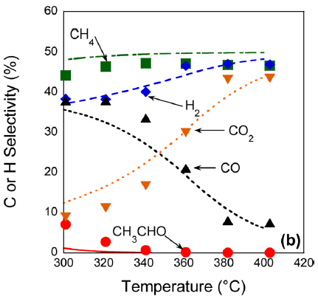
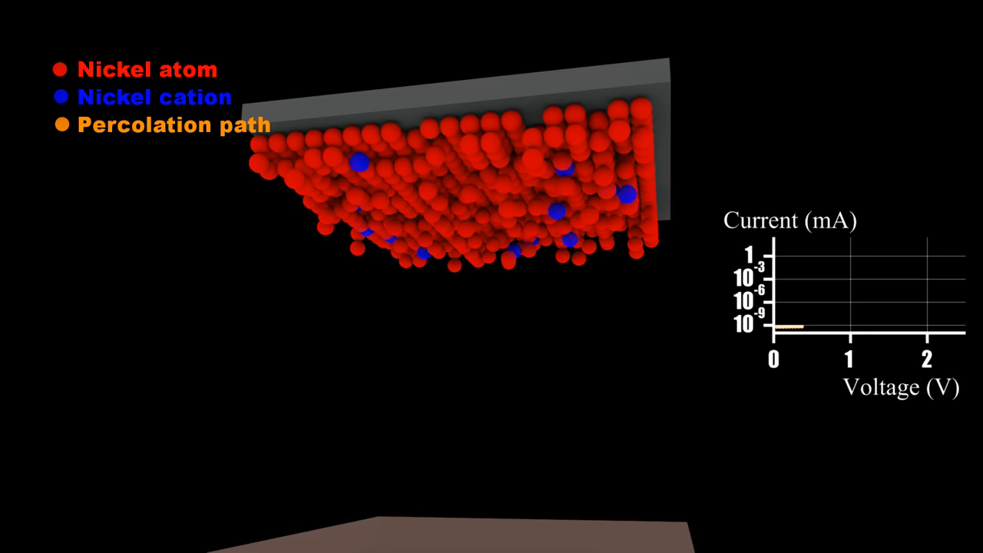
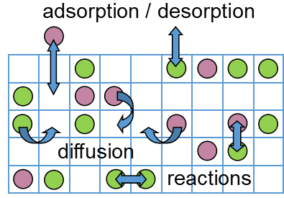
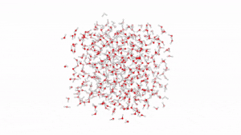
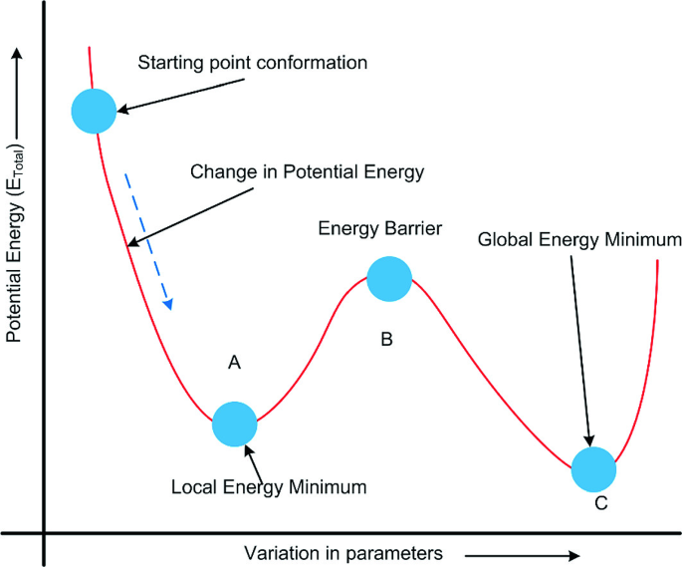
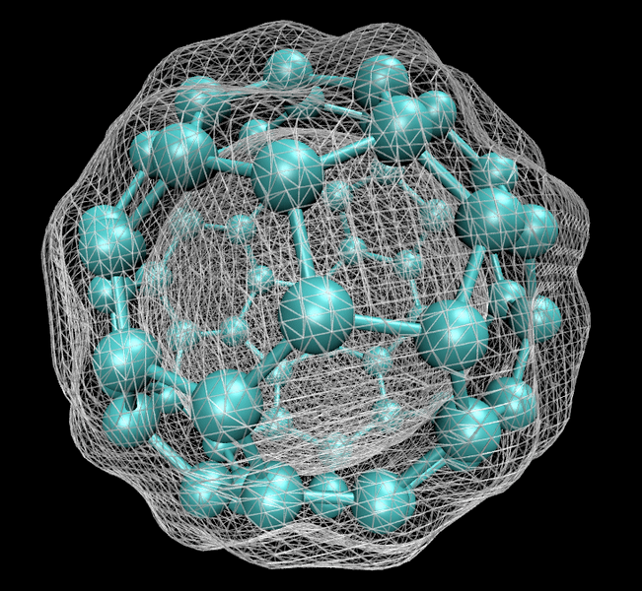

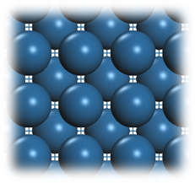
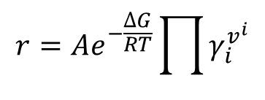
Limitations of Theoretical Simulations
Multi Scale Simulation Methods
Limitations
Phenomenological kinetics
$$r=Ae^{−\frac{∆G}{RT}}\prod{γ_{i}^{v^{i}}}$$
Lack of spatial resolution
Kinetic Monte Carlo
Molecular Dynamics
Pre-defined lattice and reactions
length scale
Density functional theory
Local equilibrium
time scale
Ideal structures

Slide 3
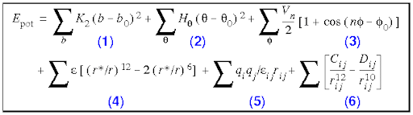
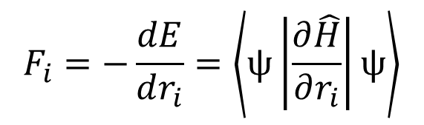
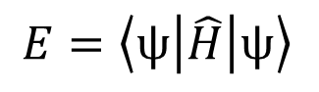
Machine Learning Potential
Simulation Methods
Potential Energy Surface
Density functional theory
$$F_{i}=−\frac{dE}{dr_{i}}=\left\langle ψ\left|\frac{∂\hat{H}}{∂r_{i}}\right|ψ\right\rangle$$
$$E=\left\langle ψ\left|\hat{H}\right|ψ\right\rangle$$
Adequately accurate, but slow
Force field
Fast but not as accurate
Machine learning potential
E
As accurate as the data and fast, but building data set takes time
F

Slide 4
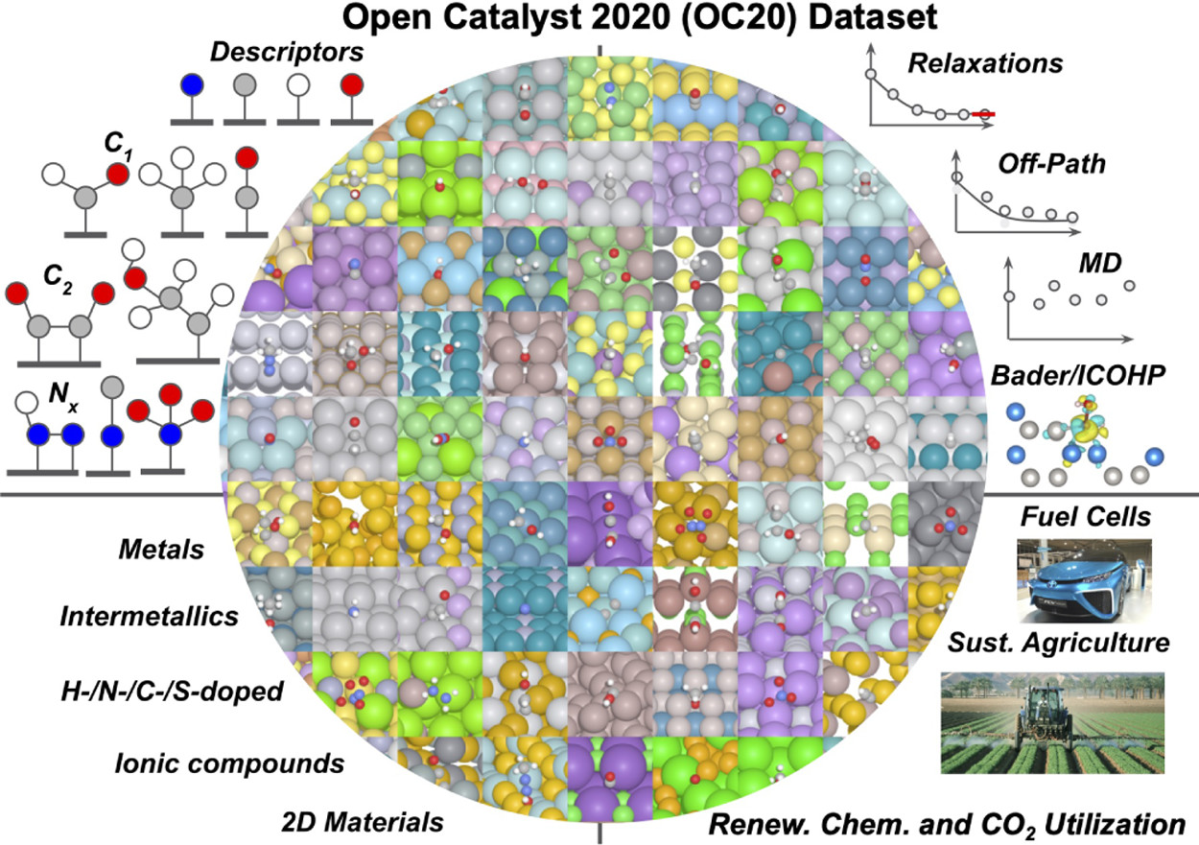
Large DFT Databases
Open Catalyst 2020
~264 million DFT data points
(Transition metal catalysts)
Open Catalyst 2022
~10 million DFT data points
(Transition metal oxide catalysts)
Materials Project Trajectory
~50 million DFT data points
(Crystals)
Ulissi and coworkers. ACS Catal. 2021, 11, 6059; ACS Catal. 2023, 13, 3066

Slide 5
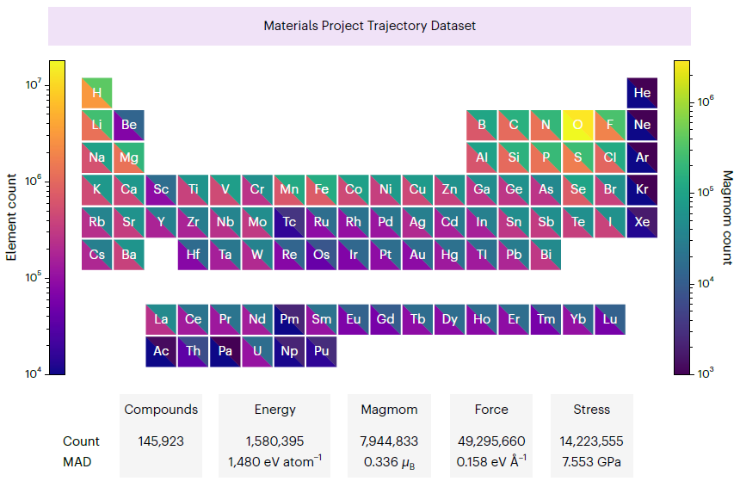

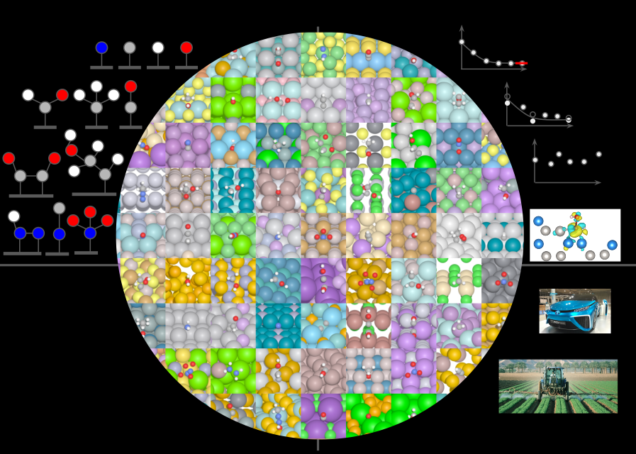
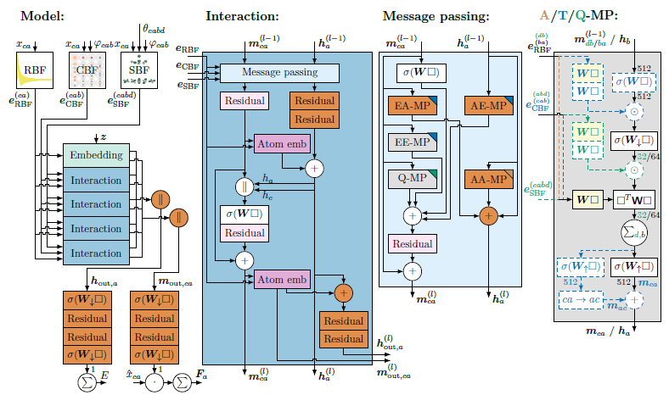
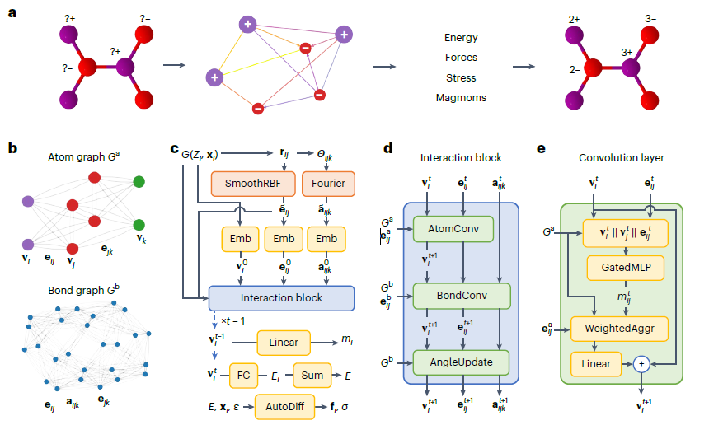
Universal Machine Learning Potential
ChgNet trained on millions of crystal data
Gemnet-oc trained on millions of adsorbate and surface data
The Materials Project
Database
Open catalyst Database
Nat. Mach. Intell. 2023, 5, 1031
ACS Catal. 2023, 13, 5, 3066
Energy MAE = 0.03 eV/atom
Force MAE = 0.077 eV/Å
Energy MAE = 0.233 eV
Force MAE = 0.021 eV/Å
Universally applicable for various materials

Slide 6
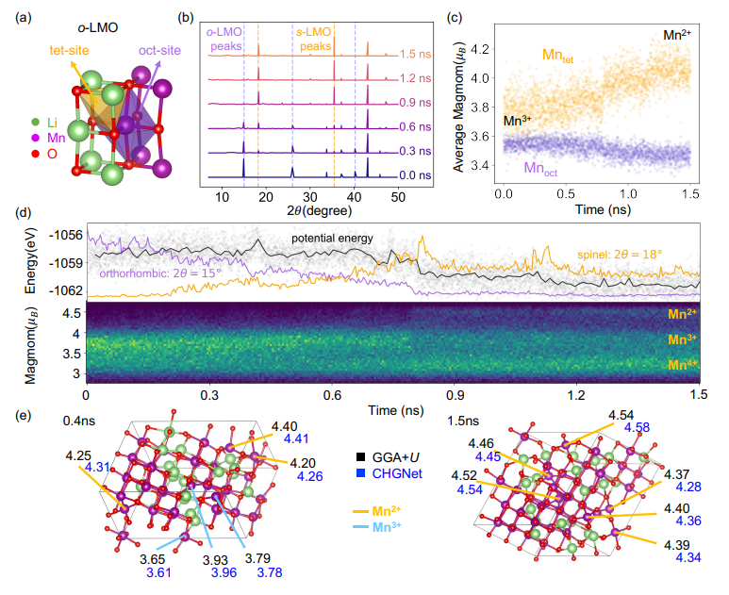
Large Scale Simulation with Machine Learning Potential
Phase transition simulation of o-Li_{0.5}MnO₂ to s-Li_{0.5}MnO₂
Application
DFT speed up
Long time MD simulation
Faster catalyst screening
Larger scale catalyst mechanism research
Interface
Coverage effect
Surface reconstruction
Phonon calculations
Superconductivity
Ionic conductivity
Ferroelectric search
Deng et al. Nature Machine Intelligence, 2023, 5, 1031

Slide 7
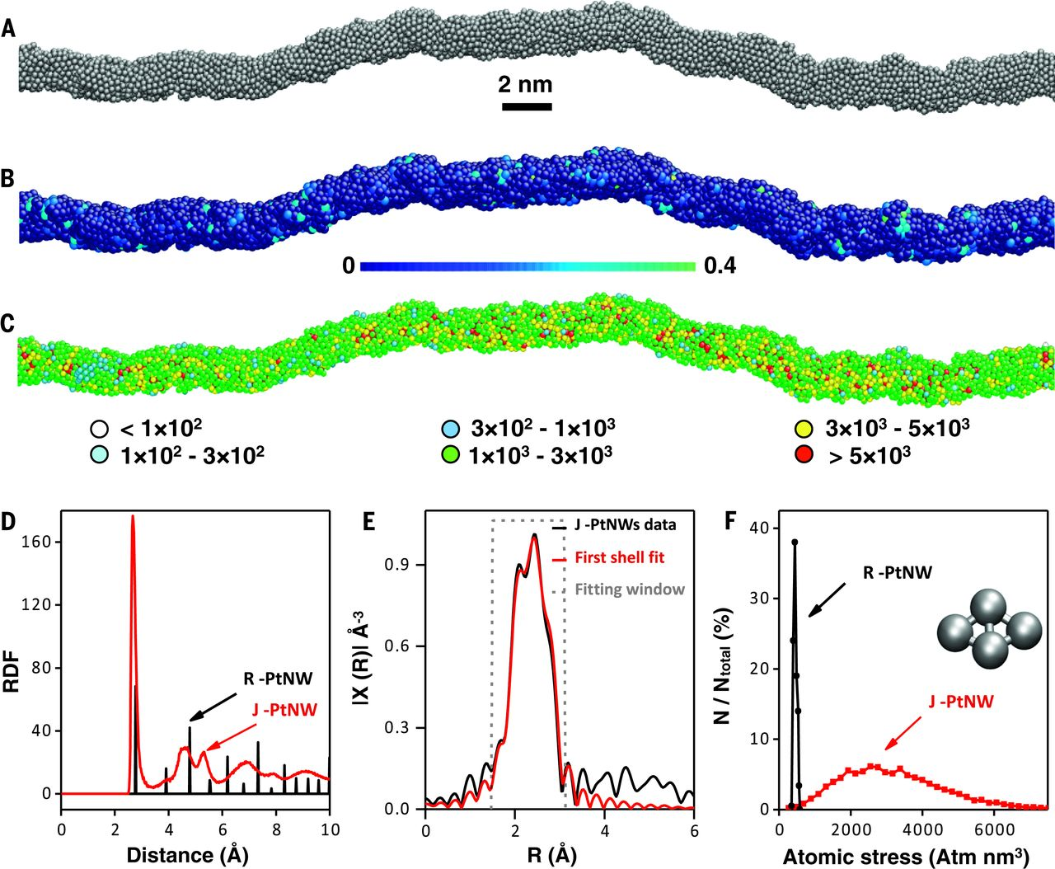
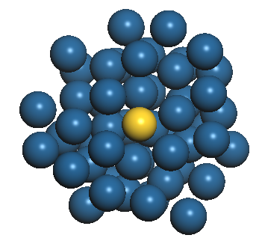
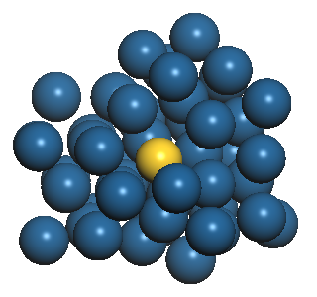
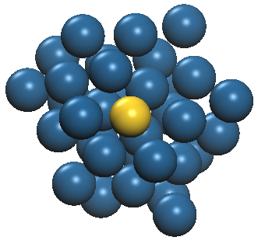
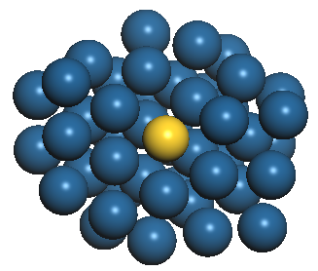
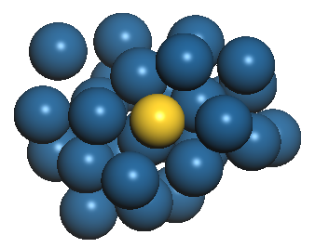

Jagged Pt Nanowire has High Specific HER Activity
2H⁺ + 2e- → H_{2(g)}
Jagged Pt nanowire increase activity¹
HER
J [A/mg_{Pt}]
>5x
Ni dealloyed from NiPt straight nanowire
Pt/C
PtNW²
~18,000 unique binding sites
10 years worth of DFT calculations
DFT-based investigation cannot be used
¹Duan and coworkers, Science, 2016, 354, 1414 ²Duan and coworkers, Nature Catal. 2019, 2, 495

Slide 8
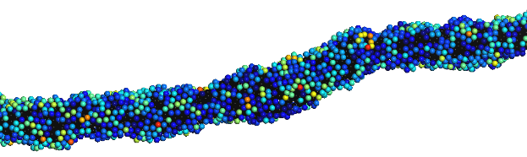
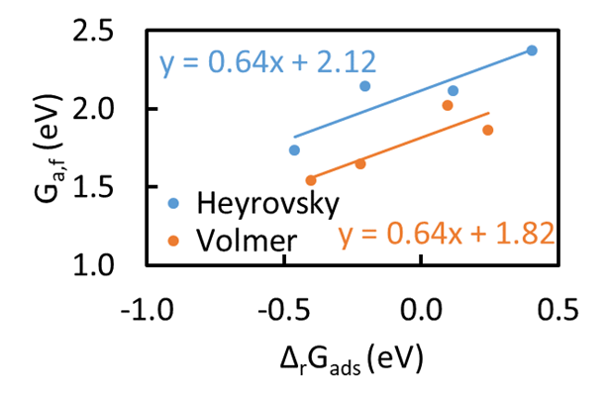
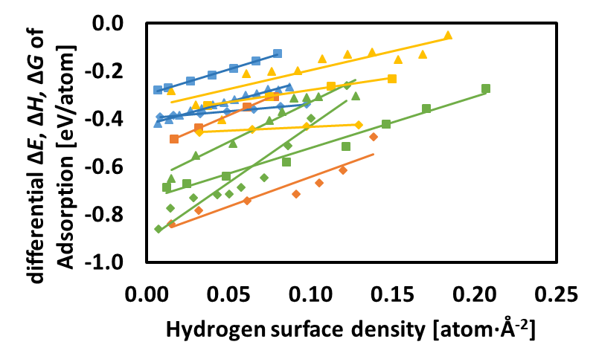
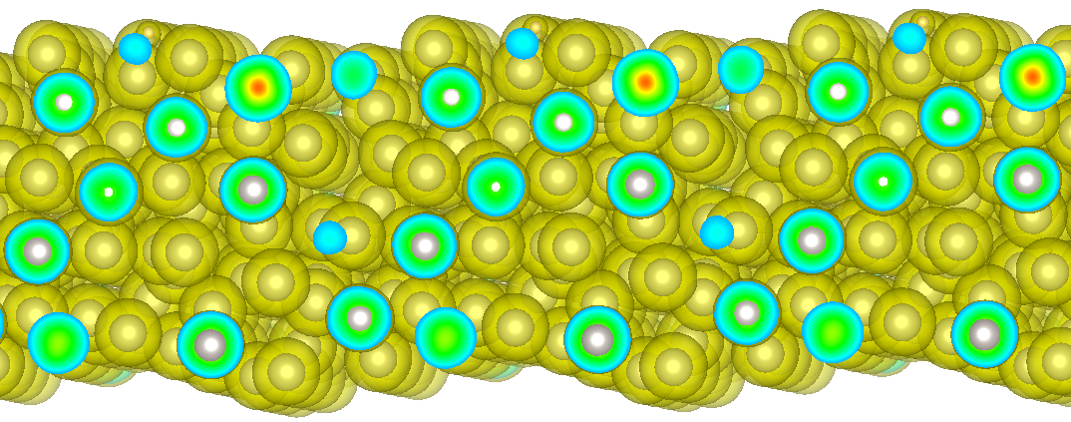
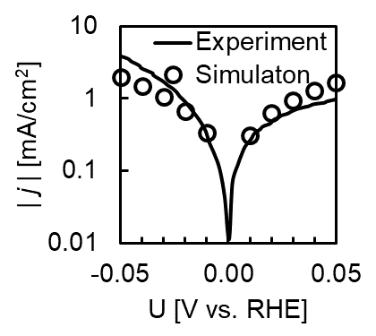
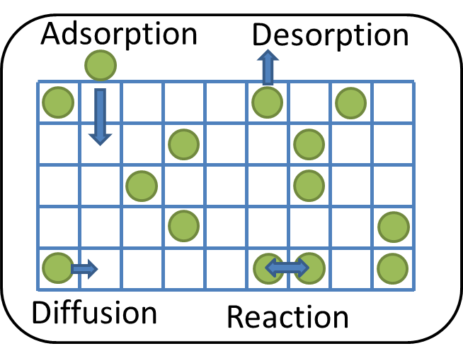
Fully Multiscale Phenomenon Simulation
Labeled Site
10² nm, 10³ ps
10⁰ nm, 10⁻⁶ ps
10² nm, 10⁻⁶ ps
10⁰ nm, 10⁻⁶ ps
Force Field
Molecular Dynamics
Density Functional Theory
Deep Learning
BEP Relations
Cluster Expansion
E
10² nm, 10⁻⁶ ps
Synthesize nanowire and slab
Build ML database
BEP relations
Predict adsorption energy
Volmer
OH-
H
Mechanistic
Insights
Model Validation
Kinetic Monte Carlo
H₂O+e⁻
Pt
Heyrovsky
H₂O+e⁻
Pt
Volmer
H₂O+e⁻
Structure Motifs
H₂+OH-
OH-
H₂
H
H
TOF, mechanism
Tafel
Pt
Human Time, length
10² nm, 10¹² ps
Gu et al. J. Am. Chem. Soc. 2021, 143, 5355

Slide 9
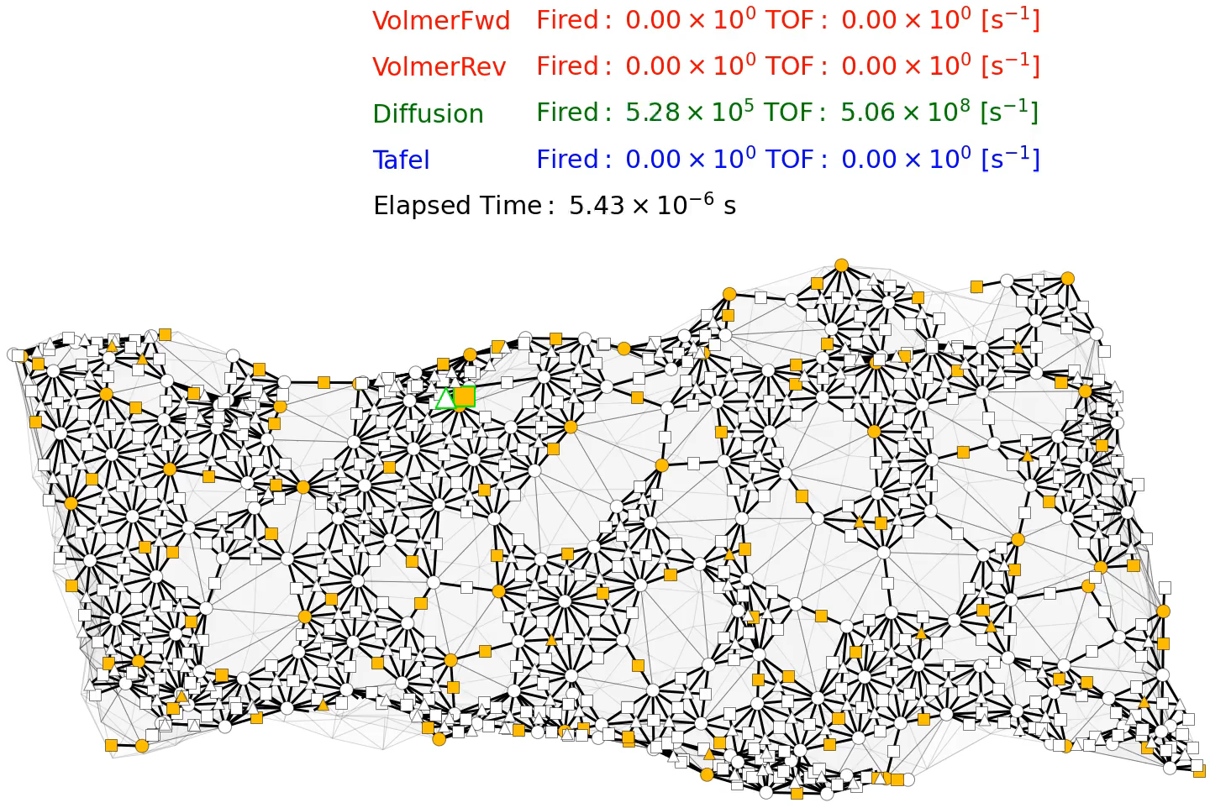
Kinetic Monte Carlo Simulation
Top site
Bridge site
Hollow site
Unoccupied
Occupied by H
H diffusion
H⁺ adsorption
H₂ gas formation
KMC Flow Chart
Start
Initialize
Select Process
$$\min_{i}{−k_{i}^{−1}ln⁡(1−u)}$$
$$u\sim U(0,1)$$
Update Graph
Increment Time
End Time?
No
Yes
End
Gu et al. J. Am. Chem. Soc. 2021, 143, 5355

Slide 10
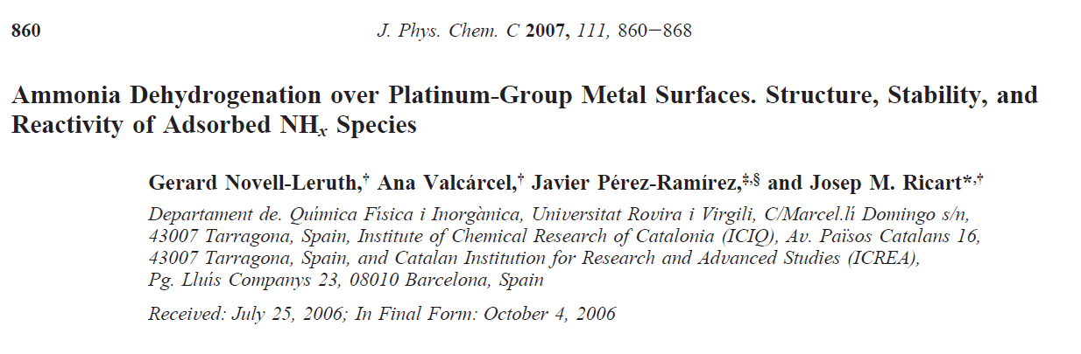
Reproducing the DFT Result with MLP
NH₃ -> NH₂ + H
NH₂ -> NH + H
NH -> N + H
on Metal Catalyst

Slide 11
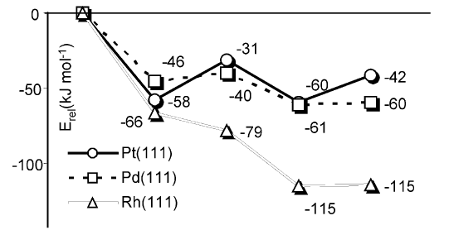
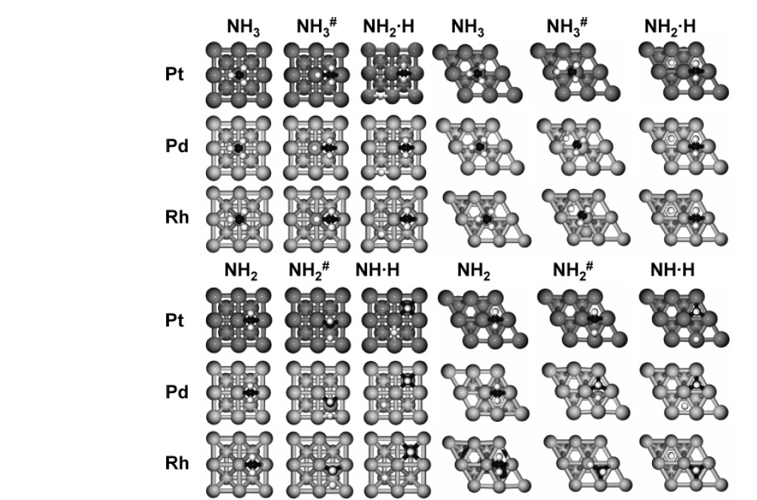
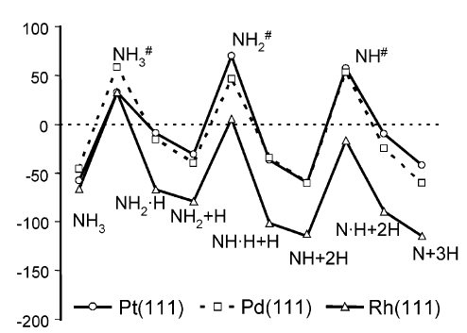
Energy Calculations

Slide 12
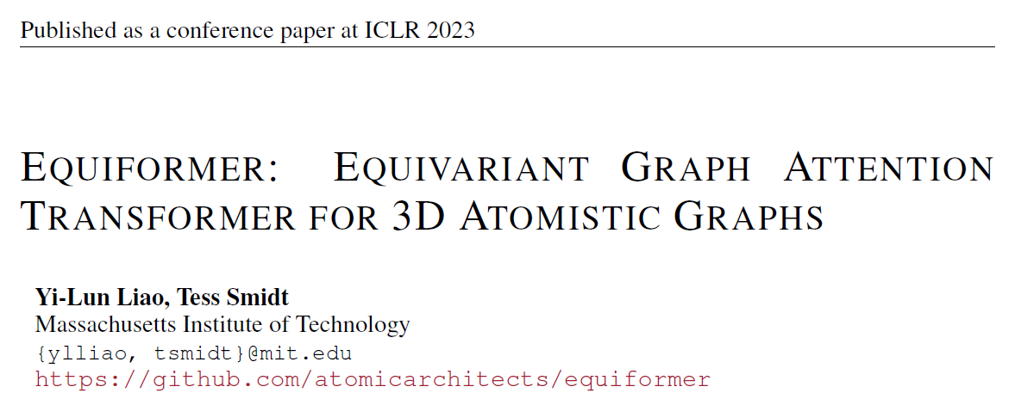
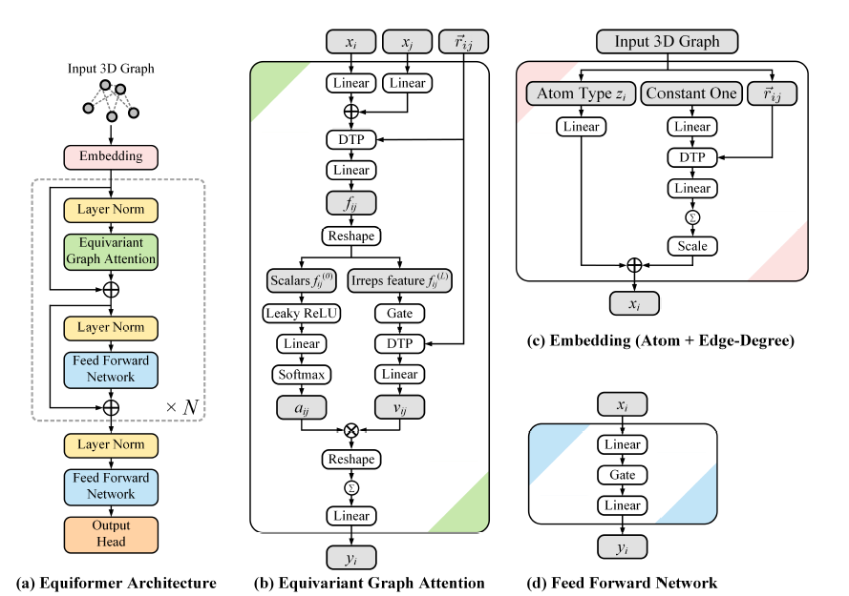
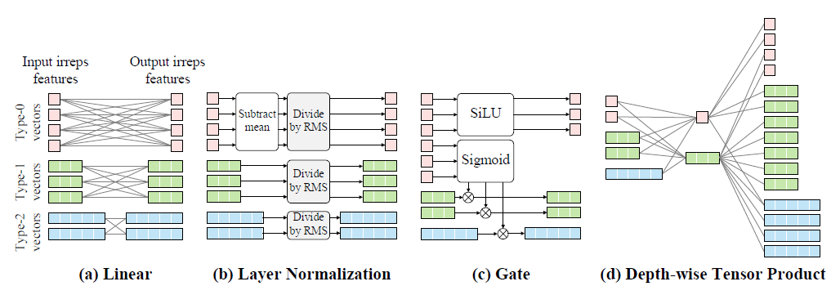
Machine Learning Model

Slide 13
Install Instruction
https://github.com/GuGroup/ocp-practice-gu
Download and install miniforge https://github.com/conda-forge/miniforge/releases/ (Miniforge3-24.11.0-1-Windows-x86_64.exe)
Download CatEnv.yml
Click search and open "Miniforge Prompt"
Go to the path of CatEnv.yml by using cd command
Type and enter "mamba env create -f CatEnv.yml"
Follow the instruction and you are all set!

Slide 14
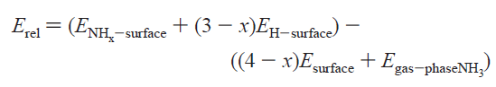
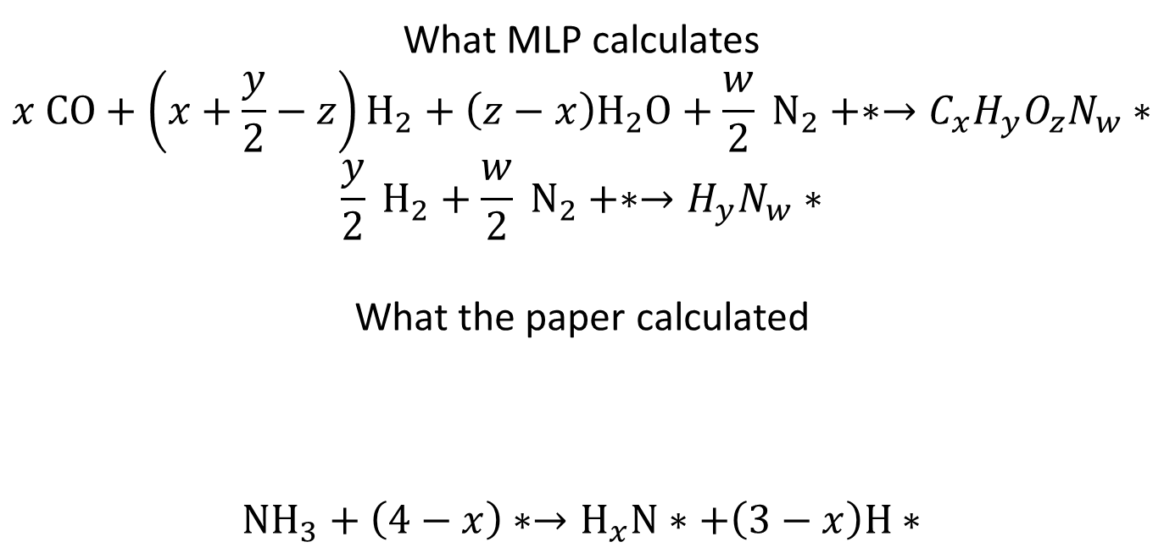
Reproducing the Result
What MLP calculates
$$x CO+\left(x+\frac{y}{2}−z\right)H_{2}+\left(z−x\right)H_{2}O+\frac{w}{2} N_{2}+∗→C_{x}H_{y}O_{z}N_{w}∗$$
$$\frac{y}{2} H_{2}+\frac{w}{2} N_{2}+∗→H_{y}N_{w}∗$$
What the paper calculated
$$NH_{3}+\left(4−x\right)∗→H_{x}N∗+\left(3−x\right)H∗$$

Slide 15
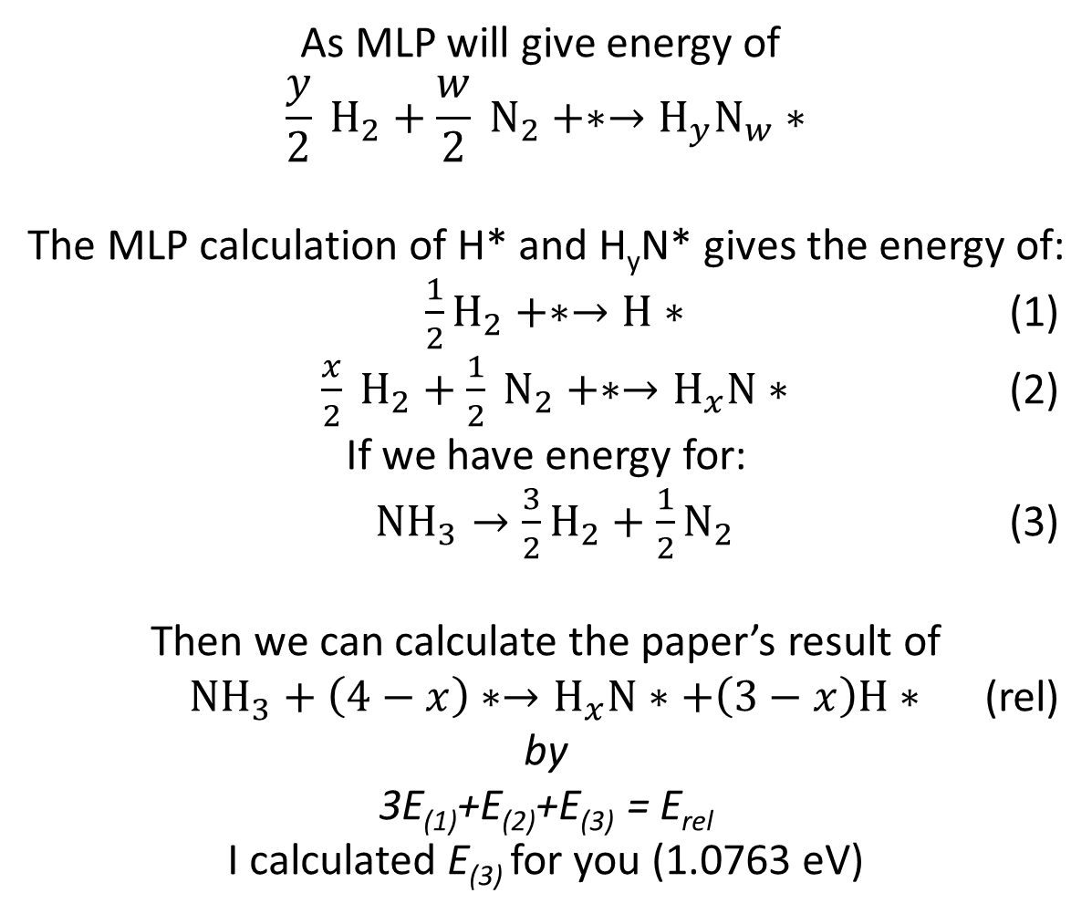
Reproducing the Relative Energy
As MLP will give energy of
$$\frac{y}{2} H_{2}+\frac{w}{2} N_{2}+∗→H_{y}N_{w}∗$$
The MLP calculation of H* and H_{y}N* gives the energy of:
$\frac{1}{2}H_{2}+∗→H∗$ (1)
$\frac{x}{2} H_{2}+\frac{1}{2} N_{2}+∗→H_{x}N∗$ (2)
If we have energy for:
$NH_{3}→\frac{3}{2}H_{2}+\frac{1}{2}N_{2}$ (3)
Then we can calculate the paper’s result of
$NH_{3}+\left(4−x\right)∗→H_{x}N∗+\left(3−x\right)H∗$ (rel)
by
3E₍₁₎+E₍₂₎+E₍₃₎ = E_{rel}
I calculated E₍₃₎ for you (1.0763 eV)

Slide 16
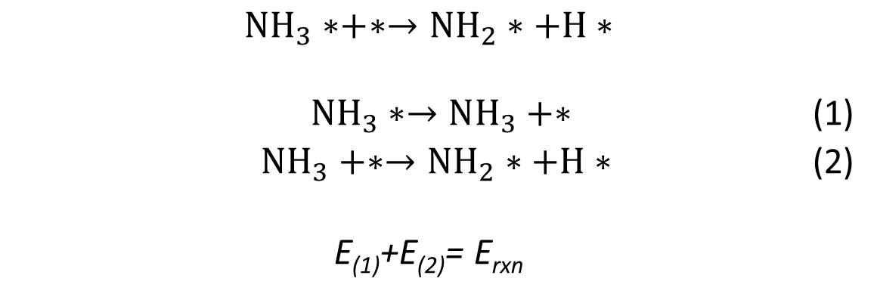
Reproducing the Reaction Energy
$$NH_{3}∗+∗→NH_{2}∗+H∗$$
${NH}_{3}∗→NH_{3}+∗$ (1)
$NH_{3}+∗→{NH}_{2}∗+H∗$ (2)
E₍₁₎+E₍₂₎= E_{rxn}

